Slide 1
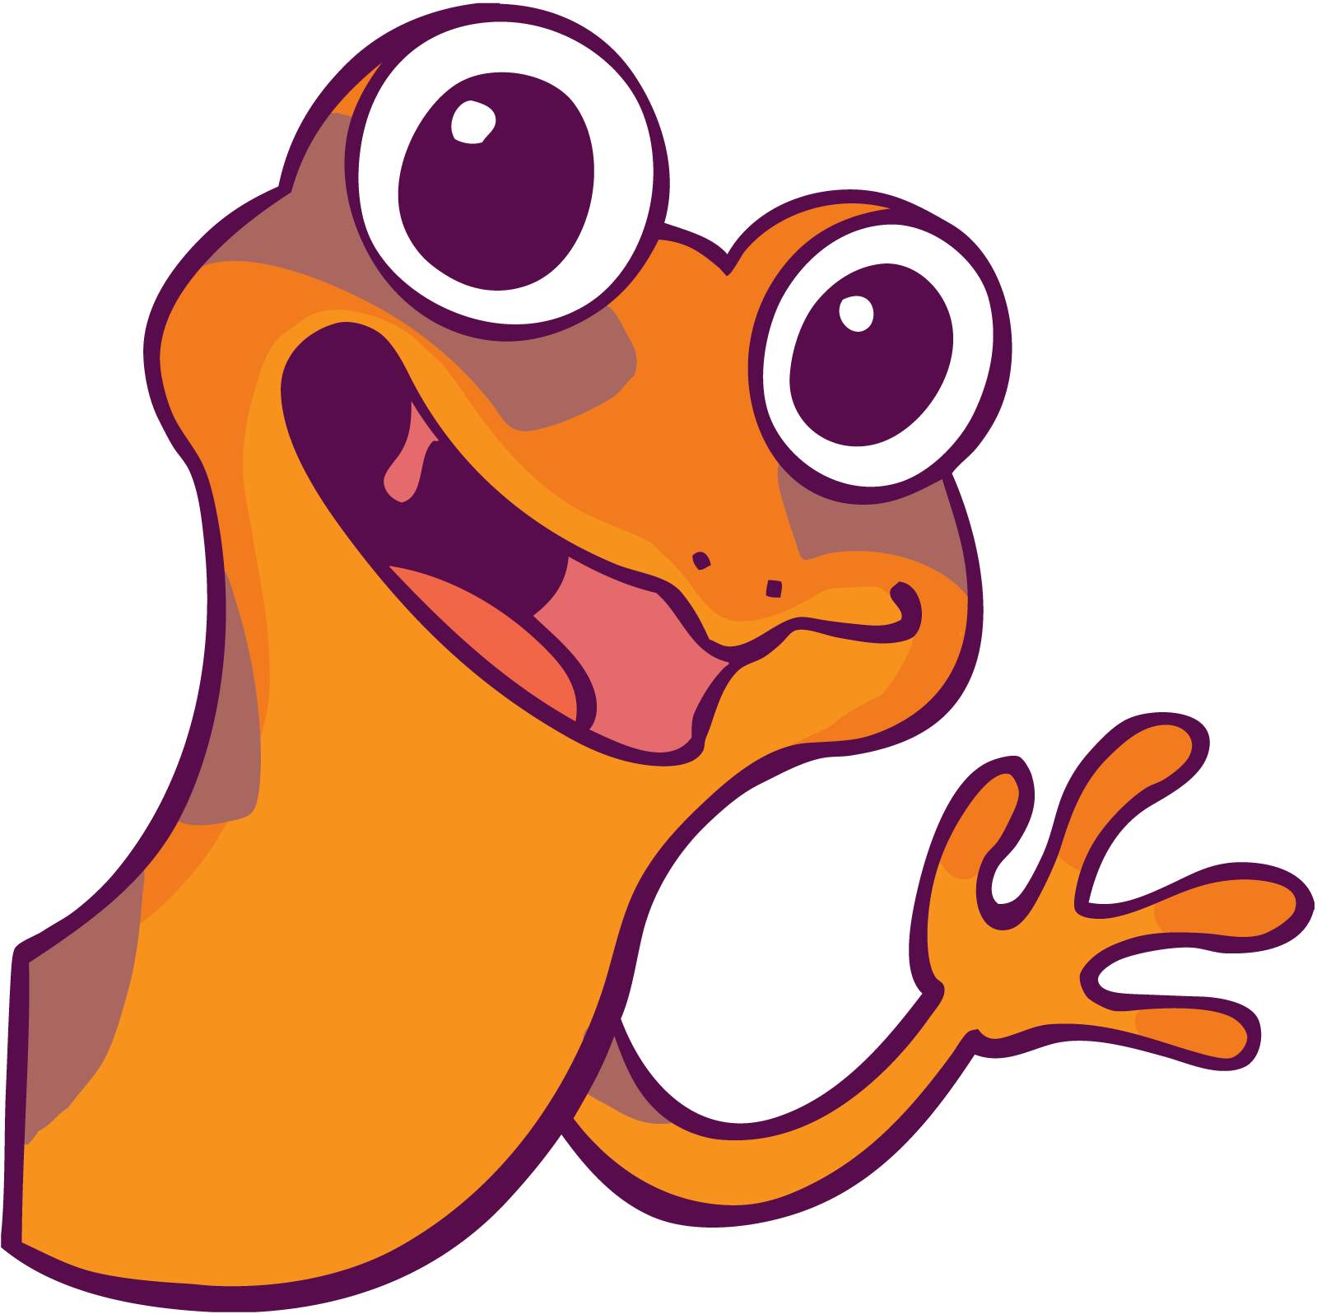
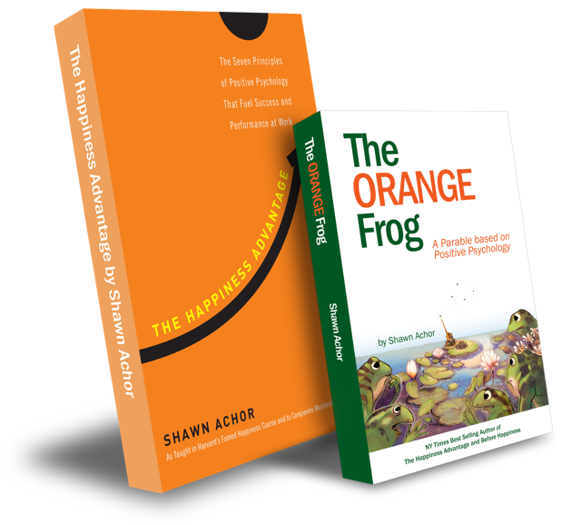
The Orange Frog
The Fun 15
By Shawn Achor

Slide 2
Week Two

Slide 3
The Fun Fifteen
Learning Objective:
I can exercise correctly, and have fun
I will discuss the importance of moving my body for at least 15 minutes a day
Notes:
Standard:
Essential Concept and/or Skill: Communicate and work productively with others emphasizing collaboration and cultural awareness to produce quality work.
Interact positively as a team member.
Cooperate with others in a group setting.
Generate ideas with group members.
Are active listeners.
Read and understand information in a variety of forms.
Express ideas.
Skill:
Active listening, express ideas

Slide 4
Skills
Self management
Responsible decision making

Slide 5
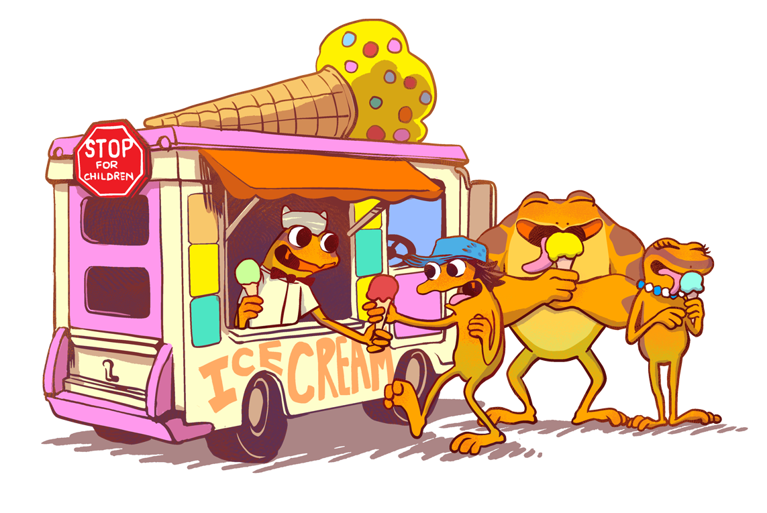
“Do you think what you do matters?
“How do you know?”

Slide 6
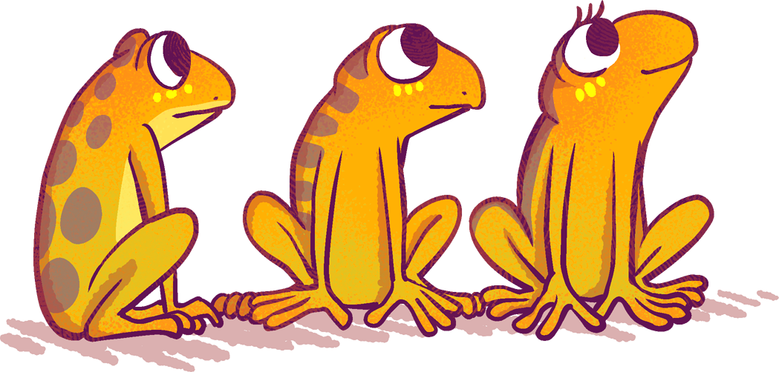
Thoughts
Bull was the character from the story that really shows us that what we do matters. He is a hard worker with a focused mindset. Working hard brings results. What if we switched gears and made this center around The Fun 15? When you exercise there are so many good things that come from it. You have a healthy body and a healthy mind. You also will have improved sleep with exercise.

Slide 7
Activity

